Slide 1
Microsoft AI Tour

Slide 2
Modernizing Security Operations Using Copilot for Security
Subtitle or speaker name
Notes:
Good day, everyone!
First off, Welcome to the AI Tour. We are happy you are here and are interested in all things AI and Microsoft. Thank you for joining us today.
I’m thrilled to kick off this insightful session on modernizing security operations with the powerful tool—Copilot for Security. As we embark on this journey, imagine Copilot as your trusty co-pilot, navigating the complex landscape of security challenges. Together, we’ll explore how it revolutionizes incident response, threat detection, and more.
Allow me to quickly introduce myself. I'm <speaker name> a <title) at Microsoft. I have firsthand experience with Copilot’s capabilities. So, hopefully my insights will illuminate the path toward a safer digital frontier.
So, fasten your seatbelts, and let’s dive into the world of modern security operations!

Slide 3
Agenda
What it is
Why it Exists
How it Works
Standalone Experience
Embedded Experience
Extensibility
Notes:
What it is:
Explore the fundamental definition and purpose of the concept.
Uncover its relevance in our context.
Why it Exists:
Delve into the motivations behind its creation.
Understand the problem it aims to solve.
How it Works:
Peek under the hood and grasp the mechanics.
Highlight key components and interactions.
Standalone Experience:
Discuss its capabilities when used independently.
Evaluate its user experience in isolation.
Embedded Experience:
Investigate how it integrates within existing systems.
Consider scenarios where it enhances other tools.
Extensibility:
Explore opportunities for customization and expansion.
Discover how it adapts to evolving needs.

Slide 4
What it is

Slide 5

Microsoft Copilot for Security
The first generative AI security product that empowers security and IT teams to protect at the speed and scale of AI
Machine learning
Threat intelligence
Data
Product integrations & telemetry
Best
practices
Skills
Product knowledge
Notes:
To get started, let's understand what Microsoft believes Copilot for Security represents.
Microsoft Copilot for Security is a generative AI-powered security solution that helps increase the efficiency and capabilities of defenders to improve security outcomes at machine speed and scale. It provides a natural language, assistive copilot experience, empowering security professionals to respond to threats quickly, process signals rapidly, and assess risk exposure in minutes.
This innovative tool integrates with Microsoft Security products, combining the advanced GPT-4 model from OpenAI with a Microsoft-developed security model, fueled by Microsoft Security’s unique expertise and global threat intelligence. Whether you’re a seasoned pro or a novice, Copilot for Security enhances your security operations, making it a valuable asset in today’s threat landscape.

Slide 6

“Microsoft Copilot for Security acts as a sort of intense and ultra-fast security consultant, able to read through complex hash files and scripts to divine their true intent, and quickly recognize both known threats and things that act like existing threats. Microsoft claims that using such a service could help address the security personnel talent shortage.”
From: Copilot for Security is not an oxymoron – it's a potential game-changer for security-starved businesses
Story by: Lance Ulanoff - TechRadar
Notes:
Now let’s look at the non-Microsoft view of Copilot for Security.
Copilot for Security has received praise from external sources, such as Lance Ulanoff from TechRadar, for its ability to address the security personnel talent shortage and act as a fast security consultant. It is considered by many to be a potential game-changer for businesses. Overall, non-Microsoft views of Copilot for Security are generally positive.
Read the quote.

Slide 7


Microsoft Threat Intelligence The industry’s largest vector coverage powered by 65T daily signals
One of the world’s largest clouds
Signal from 1.4B endpoints¹ across the planet
Graphing global internet infrastructure
+
+
1. “Microsoft by the Numbers”. Microsoft Story Labs
Notes:
Imagine a vast digital landscape where every interaction, every anomaly, and every whisper of a potential threat leaves a trace—a signal. Microsoft Threat Intelligence scours this immense terrain, collecting and analyzing data from across the globe. Here's how those 65 trillion signals become our allies in the fight against cyber adversaries:
Signal Aggregation:
- Microsoft Threat Intelligence aggregates signals from various sources: telemetry data, security events, threat feeds, and more.
- These signals span endpoints, networks, cloud environments, and applications.
Contextual Enrichment:
- Context matters. Each signal is enriched with metadata—geolocation, timestamps, user context, and threat indicators.
- This contextual enrichment transforms raw data into actionable insights.
Threat Detection and Prediction:
- Machine learning algorithms analyze the signals, seeking patterns, anomalies, and emerging threats.
- Predictive models identify potential risks before they escalate.
Threat Intelligence Feeds:
- The 65 trillion signals feed into threat intelligence feeds.
- These feeds power Copilot for Security, enhancing its understanding of threat landscapes.
Copilot for Security: Your Trusted Co-Pilot
Armed with these insights, Copilot becomes more than an AI tool—it's your co-pilot, navigating the stormy skies of cybersecurity.
Remember, behind every alert, every block, and every mitigation lies the collective intelligence of 65 trillion signals—a symphony of vigilance orchestrated by Microsoft Threat Intelligence.

Slide 8
Why it exists
Notes:
To better understand where Copilot for Security exists in the realm of security tools, let’s first understand the problem it is build to solve.

Slide 9
The odds are against today’s security analysts
Why does it exist?
4,000
Password attacks per second
72 mins
Median time for an attacker to access your private data if you fall victim to a phishing email
3.5M
Global shortage of skilled cybersecurity professionals
Notes:
Cybersecurity Challenges
The odds are against today’s security analysts.
4,000 password attacks per second—a relentless assault on digital defenses.
72 minutes: That’s all it takes for an attacker to access private data after falling victim to a phishing email.
A staggering 3.5 million global shortage of skilled cybersecurity professionals—a gap we urgently need to bridge.

Slide 10
Microsoft Copilot for Security can help
Protect at the speed and scale of AI
Catch what others miss with deeper understanding of your enterprise
Outpace adversaries and enable response in minutes, not hours
Strengthen team expertise with generative AI
Notes:
Unlocking Business Success with AI Insights
Deeper Understanding: Leverage AI to uncover hidden insights that others might miss. By analyzing data and patterns, you can make informed decisions that drive strategic growth.
Faster Response Times: Imagine accelerating your response time against competitors. With AI-powered tools, you can react swiftly to market changes, staying ahead in the game.
Team Empowerment: Strengthen your team’s capabilities with advanced AI technology. Whether it’s automating tasks, predicting trends, or enhancing customer experiences, AI is your secret weapon.
Remember, in today’s competitive landscape, embracing AI isn’t just an option—it’s a necessity for sustainable success.

Slide 11

Empowering one cybersecurity professional to operate like a team of many
Notes:
Imagine a solitary watchtower perched atop a rugged cliff. Our cybersecurity professionals often find themselves in a similar position—guardians of digital realms, standing alone against an onslaught of threats. But what if we could amplify their capabilities? What if one could operate like many?
Copilot for Security steps onto the scene—a force multiplier for our lone sentinel.
It’s not just an AI tool; it’s a trusted companion, a co-pilot navigating the stormy skies of cyber warfare.
To reiterate: Microsoft Threat Intelligence provides the fuel. Imagine 65 trillion signals—each a breadcrumb left by adversaries. Copilot harnesses this vast intelligence, transforming it into actionable insights.
Then when an incident strikes, Copilot for Security offers context, suggests actions, and prioritizes responses—all in real time
and it adapts to the ever-shifting threat landscape.
With Copilot, our lone sentinel becomes a team—an orchestra of vigilance, a symphony of defense. Empowered by AI, they decipher the signals, anticipate threats, and safeguard our digital realm.
Remember: In the battle for security, we’re not alone. Copilot is our wingman, our force multiplier—a team of many in the guise of one.
This is especially useful for those IT Pros who are tasked with security but it’s not their main job.

Slide 12
How it works
Notes:
Now let’s dig into how Copilot for Security works to supply its value to those responsible for security in their organizations.

Slide 13



Operated with simple natural language queries
Submits a prompt
Receives response
Human
Orchestrator
Build Context
Plugins
Responding
Response
Determines initial context and builds a plan using all the available skills
Executes the plan to get the required data context to answer the prompt
Analyzes all data and patterns to provide intelligent insights
Combines all data and context and the model will work out a response
Formats the data
Copilot for Security
Notes:
To better understand how Copilot for Security works lets walk through how the process works. It begins when a prompt is submitted, which initiates the sequence of events.
Next the Orchestrator takes up the request, determines initial context and builds plans using all available skills. This step is crucial as it sets up the framework for how the request will be handled.
Next, we see that a plan is executed on how to get the required data related to the prompt. It acts as an intermediary that refines and contextualizes information.
Moving forward, thanks to the extensibility in Copilot for Security, installed and enabled Plugins are utilized to analyze all data and patterns to provide intelligent insights. This step involves deep analysis and interpretation of data.
Finally, the Copilot for Security mechanism combines all data and content with the response model until we achieve our final product. The Response is then delivered back to the human user.
This entire process encapsulates how modern systems can efficiently handle requests while ensuring that each step contributes towards generating an informed and accurate response.

Slide 14
2 Experiences/1 Service
Notes:
Copilot for Security offers what we called “Experiences.” These experiences are two, very distinct ways of using Copilot for Security and understanding the differences is important to identify which to use in various scenarios.

Slide 15
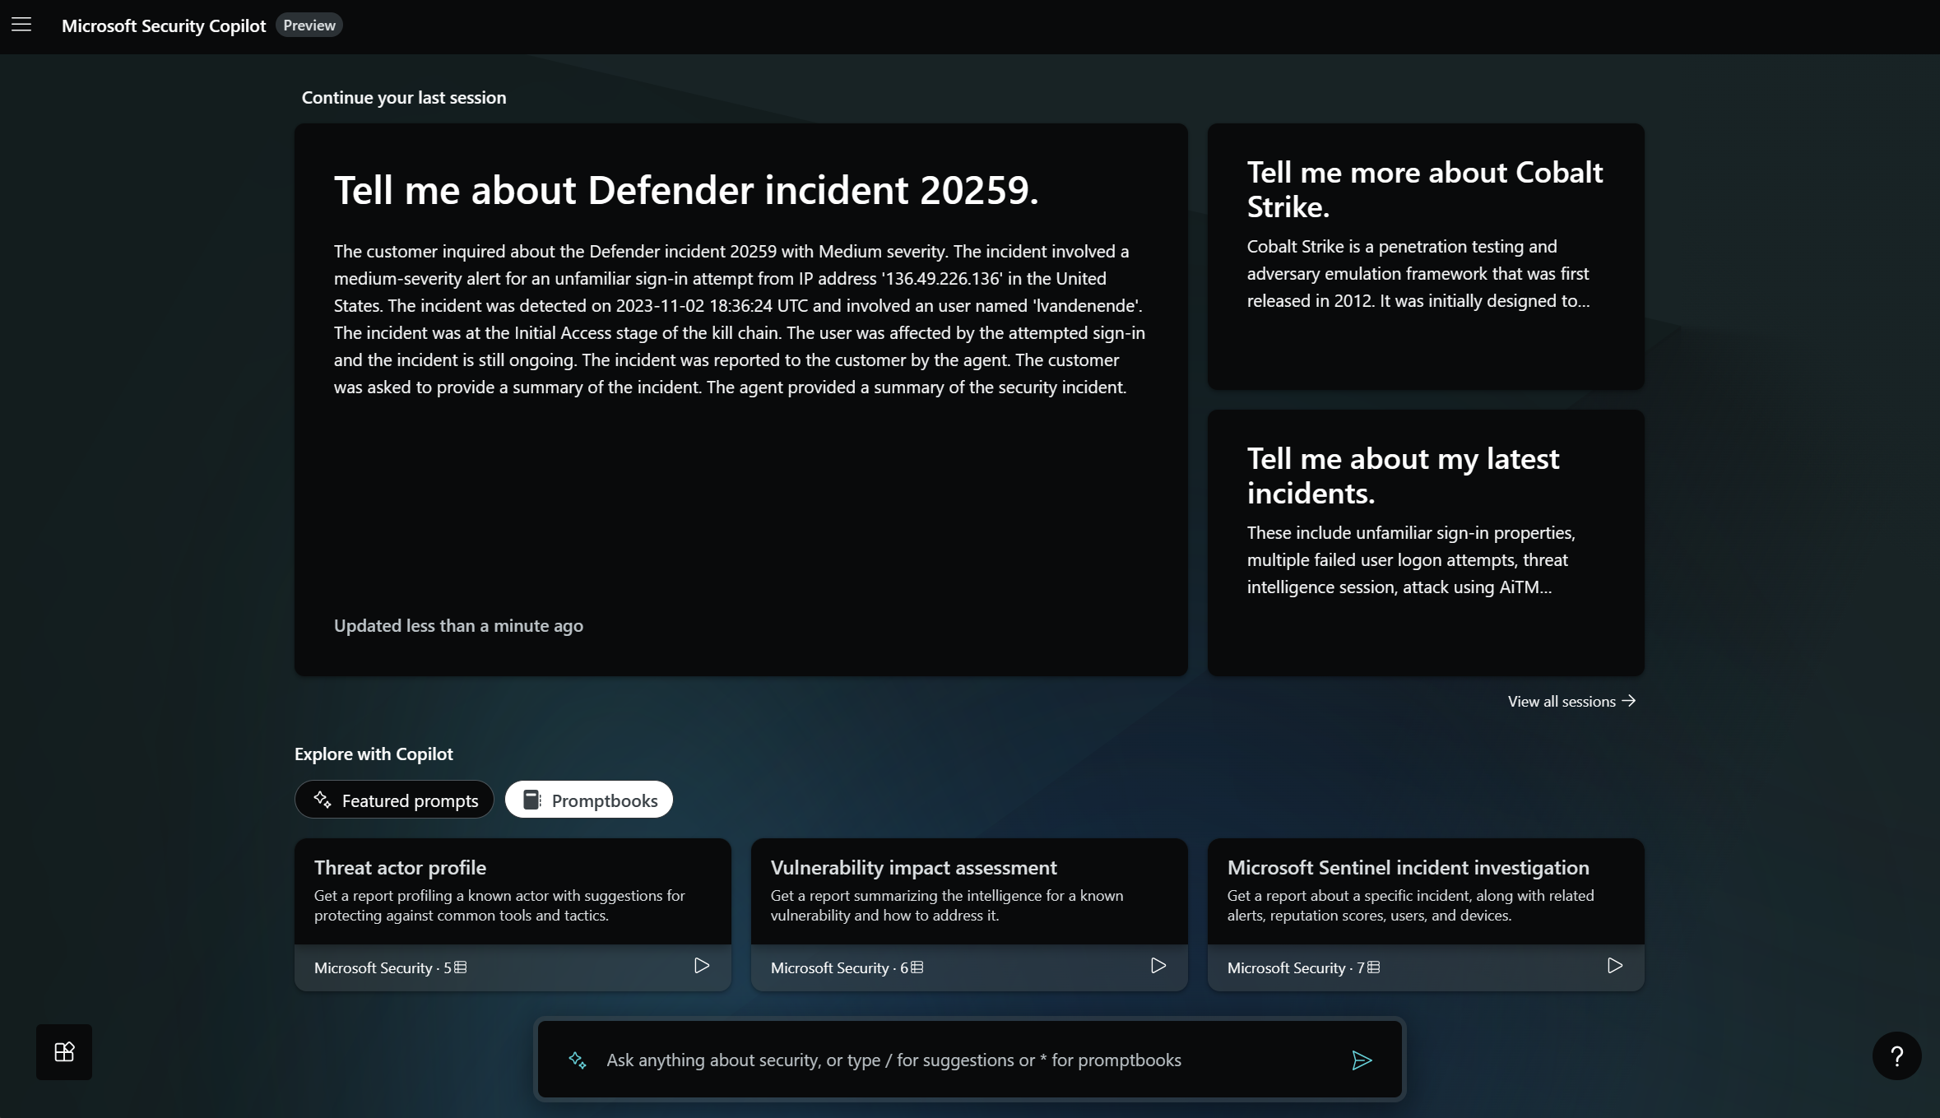
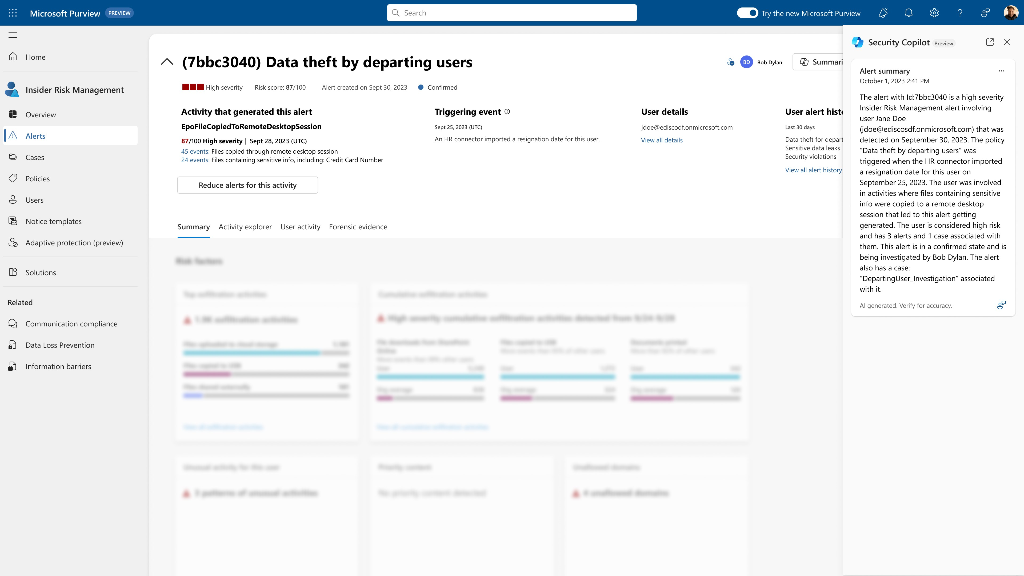
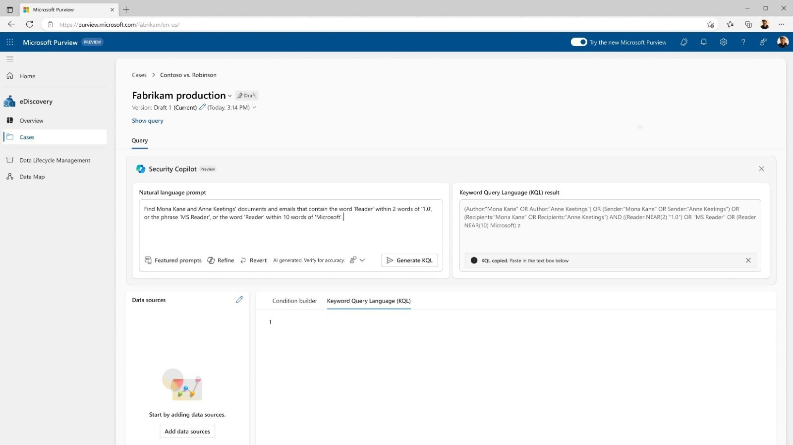
Experiences to meet you where and how you work
Standalone
Embedded
Helps teams gain a broader context to troubleshoot and remediate incidents faster within Copilot for Security itself, with all use cases in one place, enabling enriched cross-product guidance.
Offers the intuitive experience of getting Copilot for Security guidance natively within the products that your team members already work from and are familiar with.
Notes:
Copilot for Security can significantly improve our incident response and security workflows based on needs and specific scenarios.
In brief the Standalone Experience for Copilot for Security stands alone as a powerful application. It provides teams with a broader context to troubleshoot security issues. All use cases are consolidated in one place, streamlining incident management.
And the Embedded Integration is for team members already using specific tools. It seamlessly integrates within existing workflows.
Think of it as Copilot coming to you, rather than the other way around. Cross-product guidance enriches the user experience. Benefits of the Embedded integration include:
1. Gaining insights across products, enhancing decision-making.
2. Efficiently remediating incidents without context-switching.
3. Empowering team members with intuitive security guidance.
4. Boosting productivity and reducing response times.
Remember, Copilot for Security adapts to your needs, whether you prefer a standalone solution or seamless integration.

Slide 16
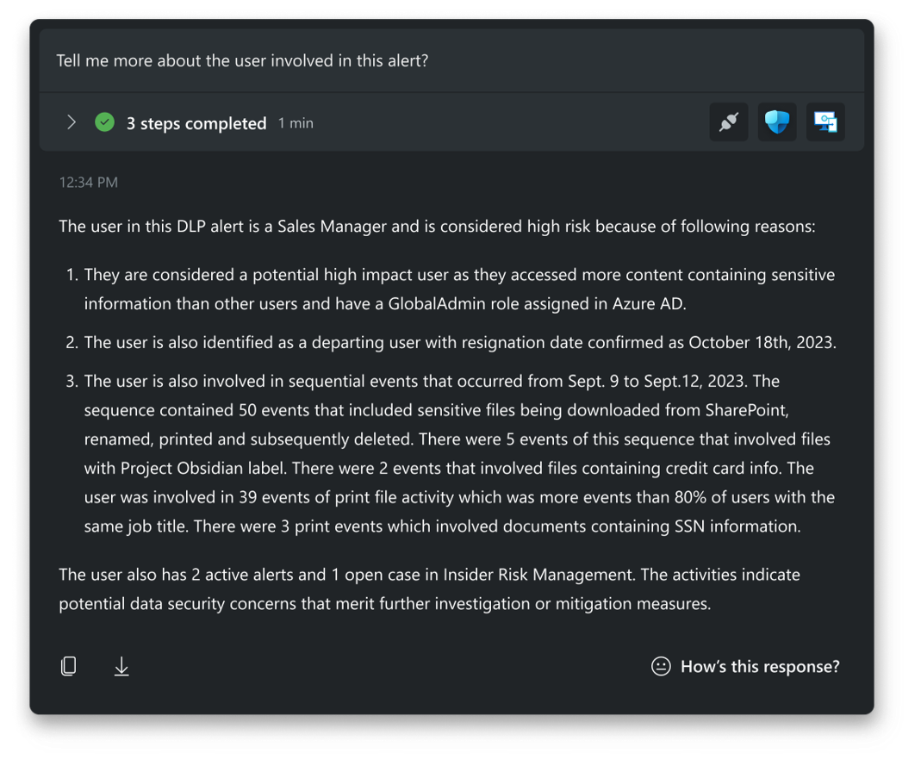

Standalone experience
End to end visibility
Determine source of an attack
Identify data at risk
In a recent randomized controlled trial to measure the productivity impact for ‘new in career’ analysts, participants using Security Copilot were 26% faster across all tasks.1
SOC
admin
1. Microsoft Security Copilot randomized controlled trial (RCT) conducted by Microsoft Office of the Chief Economist, November 2023.
Notes:
Let’s focus first on the Standalone experience.
The standalone experience for your SOC team, bringing together signals across Defender, Sentinel, Intune, Entra and Purview into a single pane view.

Slide 17
Demos
Demo 1: Using CfS TI for Hunting
Demo 2: Dissecting scripts/files
Demo 3: Generating KQL
Demo 4: Using external sources for intelligence
aka.ms/CfSAITour
Notes:
Let’s dig into the Standalone experience with a few demos.

Slide 18
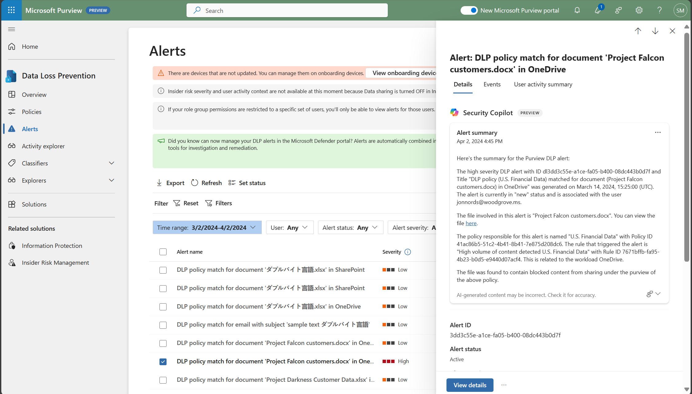


Embedded experience
Supercharge security and compliance team’s productivity with AI
Catch what others miss
Simplify the complex
Strengthen team expertise
SOC
admin
Data security
admin
Compliance
admin
Notes:
The embedded experience is for data security and compliance admins to leverage real time guidance, summarization capabilities, and natural language support. Its built directly into your proven and trusted investigation workflows. These capabilities help you accelerate time to action and mitigate the risk to your organization.

Slide 19





Microsoft Security Six product families integrating over 50 product categories
Microsoft Defender
Microsoft Purview
Microsoft Sentinel
Threat Protection & Cloud Security
Data Security, Compliance & Privacy
Identity & Management
Microsoft Priva
Microsoft Entra
Microsoft Intune
Copilot
Notes:
Current embedded experiences include Defender XDR, Sentinel, Purview, Entra, Intune, and others with more on the way.
Let’s see what this looks like through a couple demos.

Slide 20
Demos
Demo 5: Defender – auto response
Demo 6: Intune – assisted response

Slide 21
Security Platform
Notes:
While we generally refer to Copilot for Security as a security tool, it’s actually much, much more than that. In fact, in addition to its inclusion of Microsoft’s Threat Intelligence which makes its already super security smart, it’s extensibility ensures that the intelligence is always evolving to make it personal to an organization’s requirements.

Slide 22
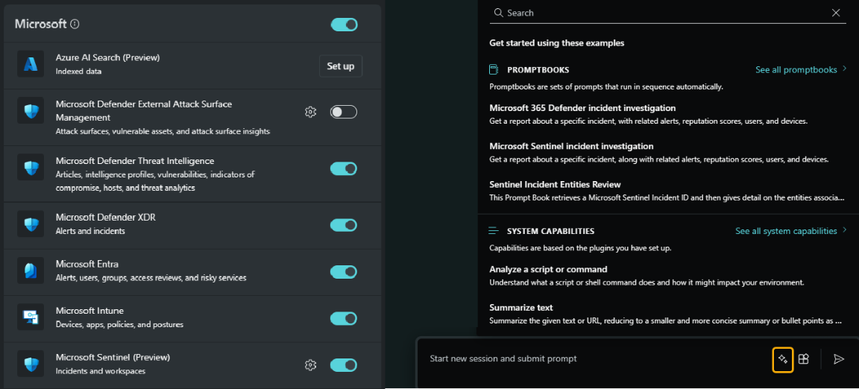
Security Framework
Microsoft Copilot for Security integrates with various sources, including Microsoft's own security products, non-Microsoft vendors, open-source intelligence feeds, and websites to generate guidance that's specific to your organization.
Notes:
I talked earlier about the extensibility of Copilot for Security.
In the ever-evolving realm of cybersecurity, having a reliable guide is essential. Copilot for Security is an extensibility platform for security, enabling organizations to tap into constantly improving intelligence.
To accomplish this...
Microsoft intelligence...
- Copilot taps into Microsoft's own security products.
- It leverages insights from Defender, Azure Sentinel, and more.
- Imagine having a unified view across your Microsoft ecosystem.
Non-Microsoft intelligence
- Copilot extends its reach to non-Microsoft security vendors.
- It harmonizes data from diverse tools—SIEMs, firewalls, EDRs.
- The result? A comprehensive, cross-vendor perspective.
Trusted External sources...
- Copilot doesn't stop there—it can also feed on open-source intelligence.
- As already mentioned, through MDTI it has access to global threat landscapes, emerging vulnerabilities, and attack patterns - (and arguably Microsoft's own Threat Intelligence is the best in the industry), BUT through additional capabilities it also enables organizations to take advantage of their own organization-specific policies and knowledge and also trusted external resources. This real-time data enriches its guidance.
Remember, Copilot isn't just an AI—it's your strategic partner, guiding you through the security maze.

Slide 23

















































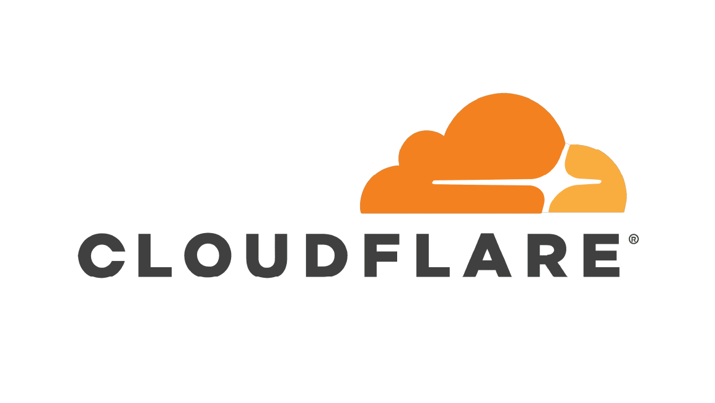





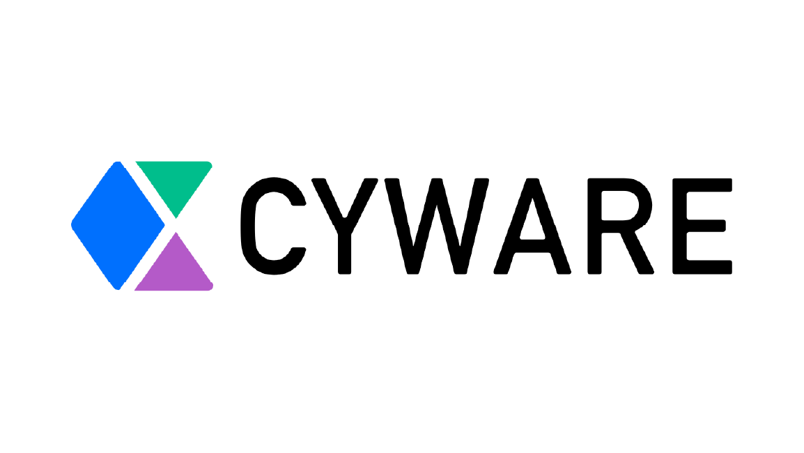


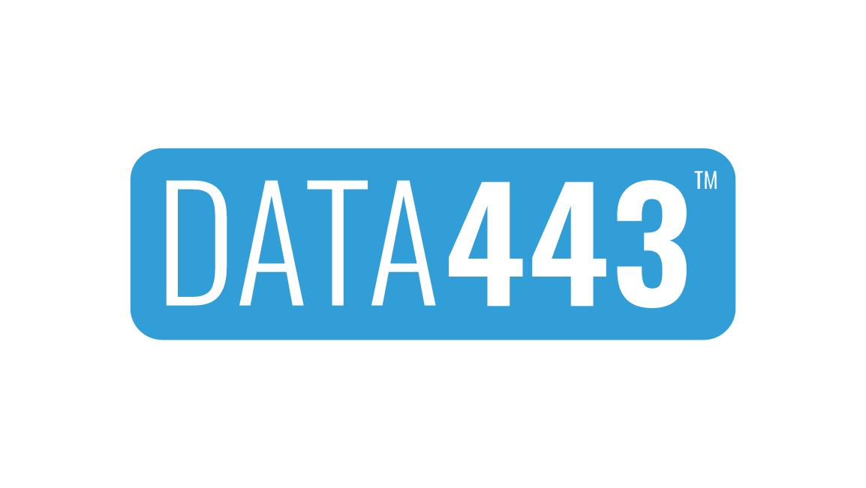



















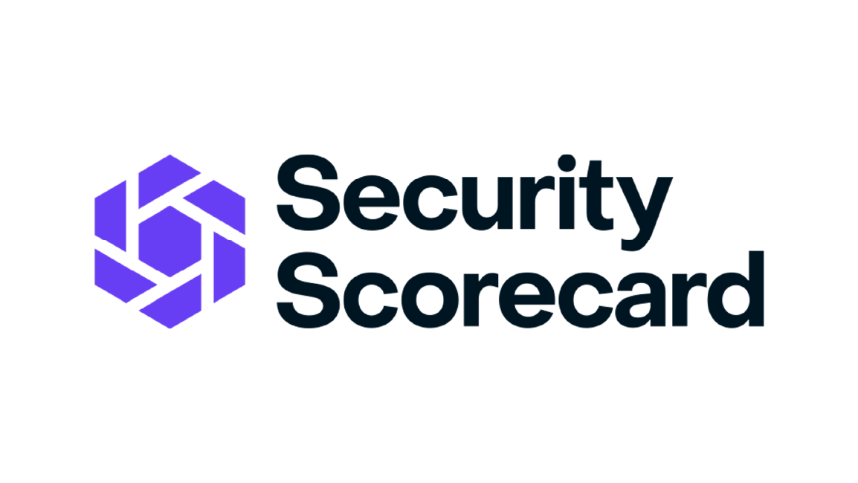


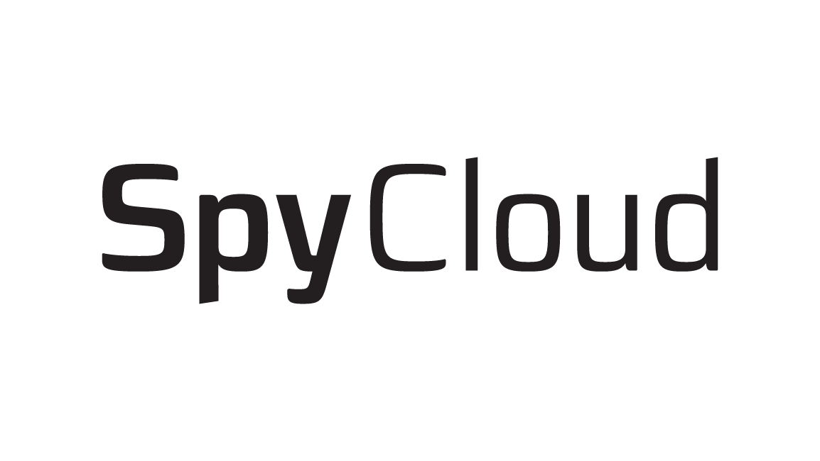
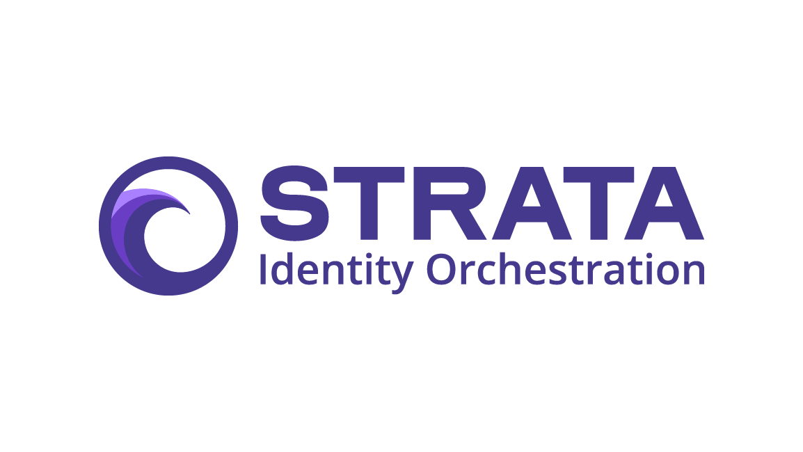









Sample partner integrations and plugins
Managed Security Service Providers
Independent Software Vendors
*With existing plugins for Splunk and ServiceNow already available in early access.
Notes:
As an example, this slide represents our 3rd party partners that are already developing solutions to work with Copilot for Security. And this list continues to grow rapidly.
This is a big slide with lots of partners, but let me just highlight a few that may be more familiar to you like Tanium, Difenda, BlueVoyant, PWC, Lenovo, and Cisco.

Slide 24
Extending Intelligence Through Custom Plugins
Types:
API - Transform an existing API into a Copilot for Security API plugin. If the API already has an OpenAPI Spec, you can use that. Host the OpenAPI spec and create a new plugin manifest file.
GPT - You can use an existing OpenAI Plugin by uploading its manifest file. This allows you to leverage external functionality within Copilot for Security.
KQL - Allows you to create powerful connectors using KQL queries.
Notes:
Copilot for Security currently offers 3 types of ways to extend functionality. Through the OpenAPI spec, through standard GPT manifests, and by utilizing Kusto Query Language.
Let’s dig into this functionality through a demo.

Slide 25
Demos
Demo 7: Installing, Enabling and Using Plugins

Slide 26
Conclusion
Notes:
I know it’s been a whirlwind of information today, so, let’s spend some time pulling this all together.

Slide 27





Making organizations more secure
“It’s a time saver. I don’t have to go into 50 different tools to do an investigation.”
SOC Director,
Fortune 100 Chemicals
“When we need to check for IOCs, it takes 10-15 minutes for an analyst to do it. It took Security Copilot 3 minutes to do the same.”
CISO, Global Ecommerce
“Generating reports would be a huge time saver. It is probably our most time-consuming function at this time.”
Head of Security,
Global Consultancy
“I use Security Copilot as a sanity check. he generated KQL query gets me 80% of the way there.”
CISO,
Fortune 500
Construction
“We’ve been using it during actual incidents. It gave a great explanation of 537 lines of code in about a minute.”
SOC Director,
Fortune 100 Chemicals
Notes:
So, today, we’ve dove together into the deep end for the real-world impact of Microsoft Copilot for Security. These testimonials you see here come straight from the trenches—security professionals who’ve witnessed its prowess firsthand.
But just a quick summary:
Through its single pane view, it saves time in various ways. Its security intelligence makes your organization more intelligent.

Slide 28

What can Copilot do for you?
Analyze the following script <INSERT SCRIPT>
Summarize Sentinel incident <SENTINEL_INCIDENT_ID>
Why was <USERNAME> prompted for MFA?
Generate and run a KQL query within Microsoft Sentinel to hunt for break-glass account usage
Show me the top 5 DLP alerts I should prioritize today
Tell me about Defender incident 20259
Describe the impact of this policy on users and highlight setting conflicts with existing policy
Notes:
Of these testimonials, here’s just a few of some of the biggest use cases:
Summarizing security incidents
Reverse engineering potentially harmful code.
Helping to identify flaws in existing security measures.
Building valuable, optimized KQL queries on the fly.
Developing and improving existing security policies.
Creating reports in multiple types and for different audiences.

Slide 29

Uplevel junior
analyst talent
Strengthen team expertise to focus on what matters
Enable less experienced team members to perform tasks normally reserved for mid to expert-level analysts, e.g., KQL data querying
Reduce experienced analyst fatigue
Enable your team with capabilities normally available only to the expert professionals, such as script and malware analysis
Build consistency
in operations
Get step-by-step guidance on processes such as incident response to ensure thorough response and consistent execution across team members
Notes:
Finally...
In the dynamic world of teamwork, efficiency and focus matter. We can empower our teams using Microsoft Copilot for Security by streamlining expertise so teams can focus on what matters most. Getting stuck in the weeds in a security event is disastrous.
With Copilot for Security you can...
Enable less experienced team members to perform tasks normally reserved for mid to expert-level analysts.
Reduce experienced analyst fatigue: Enable your team with capabilities normally available only to the expert professionals, such as script and malware analysis.
Build consistency in operations: Get step-by-step guidance on processes, such as incident response, to ensure thorough response and consistent execution across team members.

Slide 30
Microsoft Logo
Q&A
Notes:
So, I’m happy to take any questions now, or if you have other commitments, find me to discuss after this session.
Thank you so much for your time today and I hope your AI Tour is an awesome one!

